Slide 1
Programming Logic and Design
Week 4 - Flow Control, second part
for loops and while loops

Slide 2


Loops - repeating things
Computers were designed to help automate boring, repetitive tasks
Loops are used for repeating tasks, for example
Creating an official transcript for every graduating student
Image filtering - converting every pixel in an image
Keep asking for input until the user enters valid data
Add up every temperature over the winter to compute the average
@jorengoessens

Slide 3
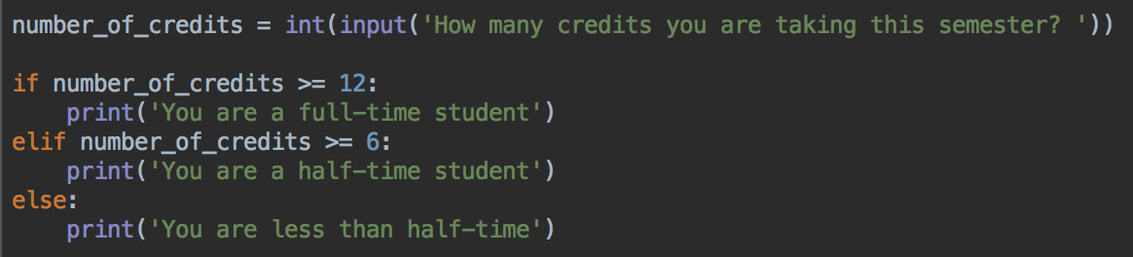
while loops
Remember the full-time, part time program?
What happens if you enter -10 for the number of credits?

Slide 4
while loops
Remember the full-time, part time program?
What happens if you enter -10 for the number of credits?
I guess that's correct..
But it's not possible to take a negative number of credits
So, it would be better to ask the user to try again if they enter an invalid number

Slide 5
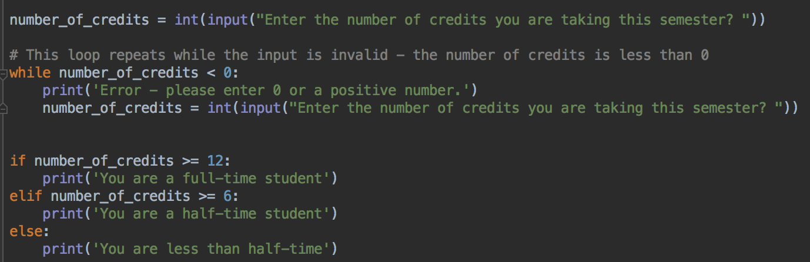
Modify the full time program like this

Slide 6
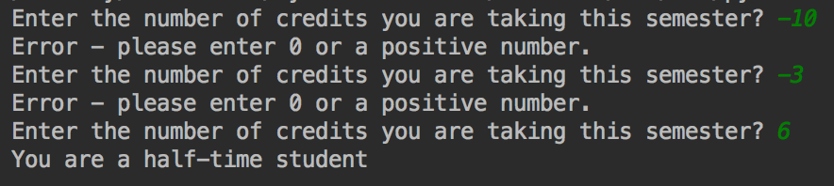
Run and test
Try with example negative and positive numbers
As soon as you enter a positive number, the program will continue to the if-statements to check full time, half time
If the first number entered is positive, there's no error message

Slide 7
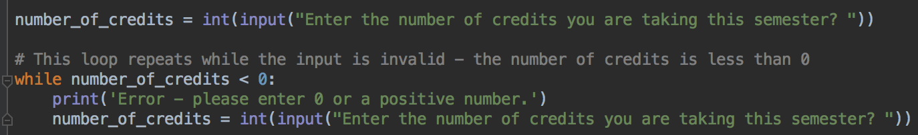
while loops
Structure is like a if statement
But, if the condition is true, the code inside the while block repeats
And repeats
And repeats
....
Until the condition is true
A condition, something that's True or False

Slide 8
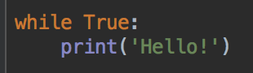
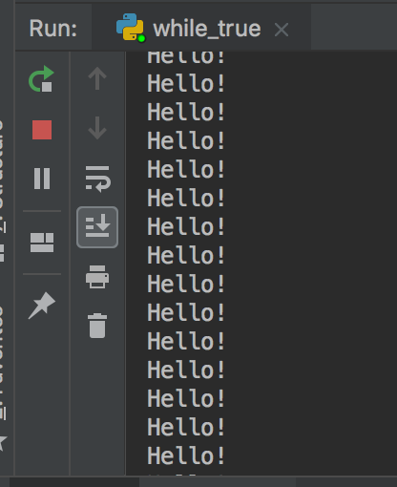
while True
Start a new program and write this code. What does it do?
Press the red stop button to stop your program

Slide 9
While loop
Its more common to have a condition that depends on variables that are modified inside the loop

Slide 10
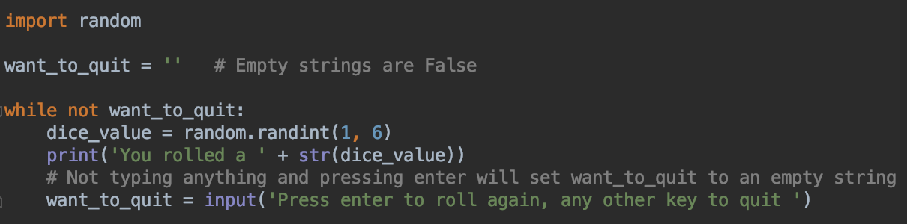
while loop - repeat as many times as the user wants
Remember that empty strings are falsy

Slide 11
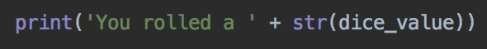
String formatting
Replace this line
With this version - notice the f at the start of the string
The variable dice_value is inside { } and is part of the string
Run the program again. What does the output look like?

Slide 12
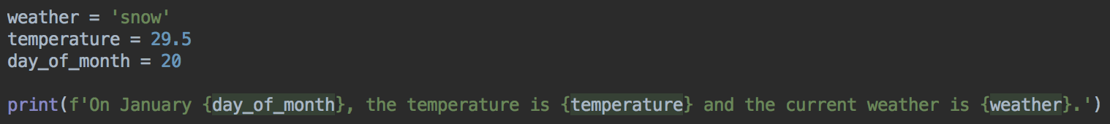
Formatting Strings
Put f before the string
Put your variables - of any type - inside { }
The string will contain the value of the variables
No need to convert to str()

Slide 13
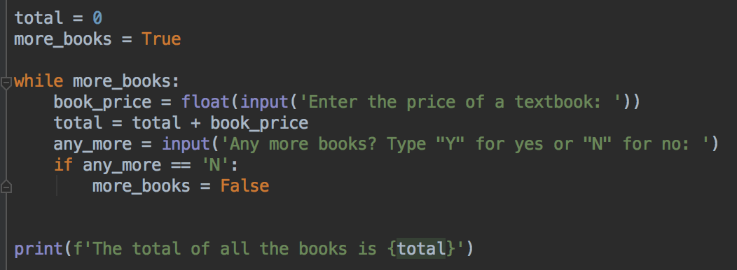
Format strings
More concise and easier to type
Format string

Slide 14
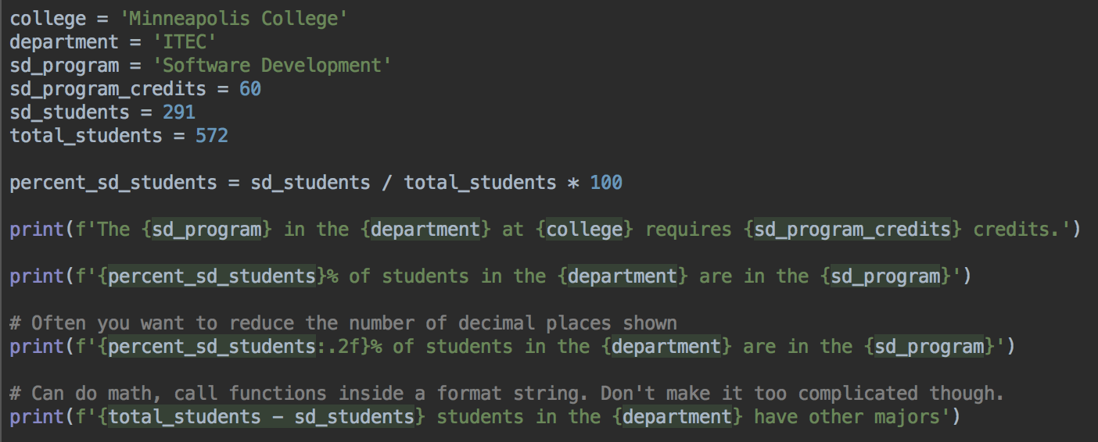
Format strings

Slide 15
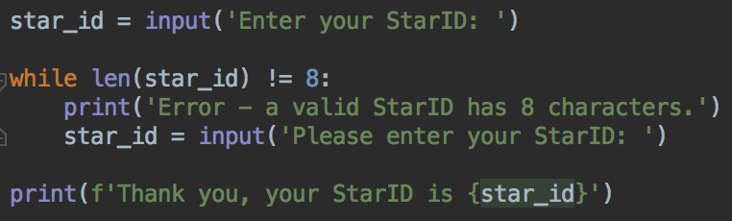
While loops
Validating a string - does a StarID have 8 characters?
An improvement would be to checking if the StarID is in the correct pattern ab1234dc. See extra credit question in lab

Slide 16
If statements and while loops
You can put if statements inside while loops
You can put a while loop inside an if statement
Combining loops, if-statements, and functions (next week) is how we can build more complex, useful, and interesting programs

Slide 17
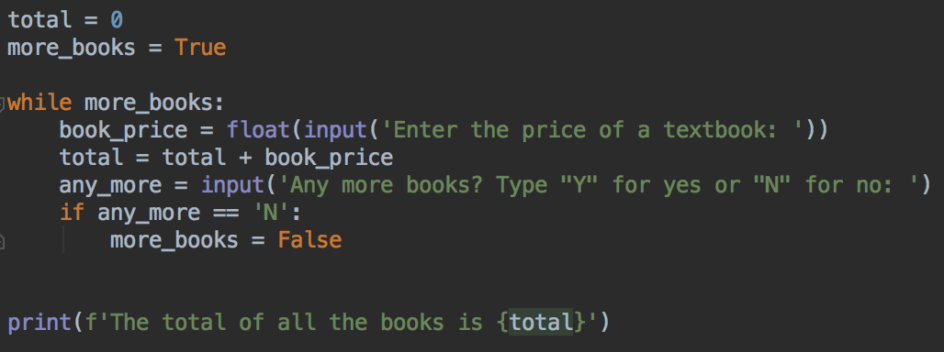
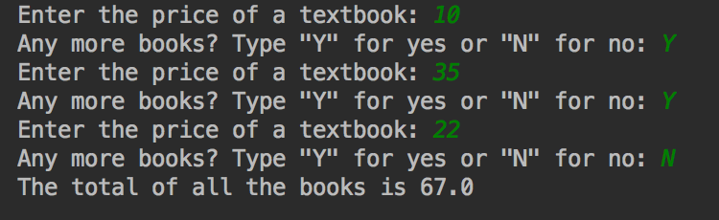
While loop - repeat until user is done

Slide 18
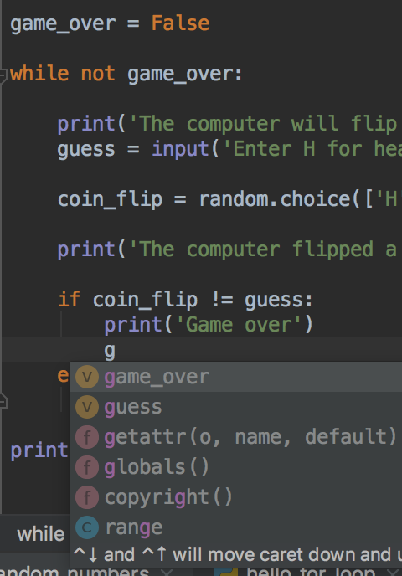
Variable names
Good practice: use descriptive variable names
Try and describe what data is in your variable
Good variable names are concise but informative
PyCharm and other editors have autocomplete so even if you have a longer variable name
Press tab while you are typing to autocomplete PyCharm's suggestions
Use up and down arrows to move between suggestions
Pressing tab now would autocomplete game_over

Slide 19
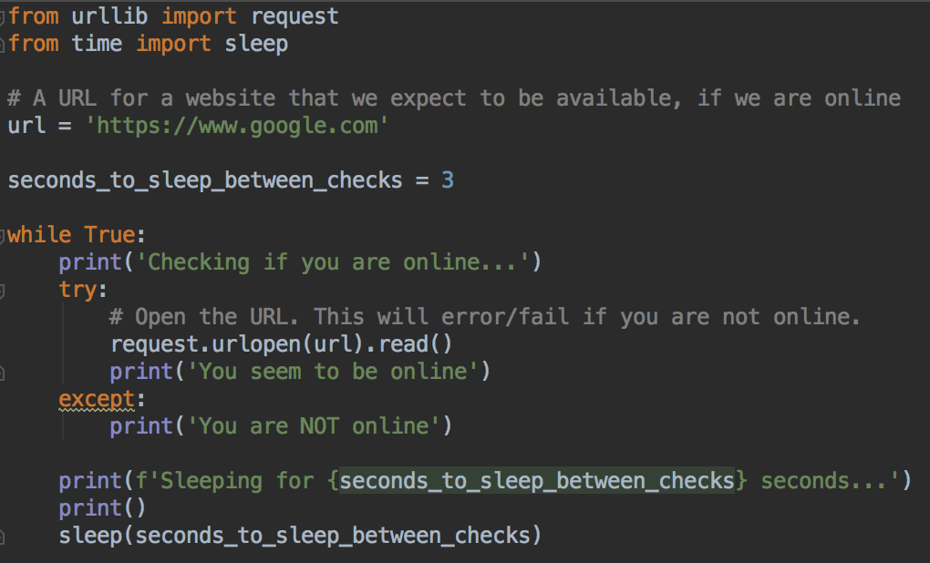
While true loops can be useful
First useful program
Press red stop button to end the program
Testing if you are online
Could extend this program to make a noise when you are online

Slide 20
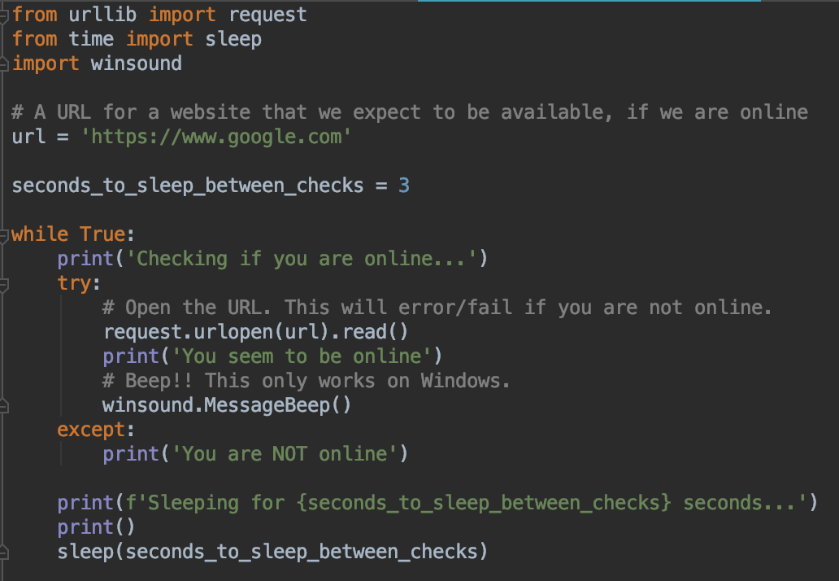
Making a sound when you are online: Windows
Add these lines
Beep!

Slide 21
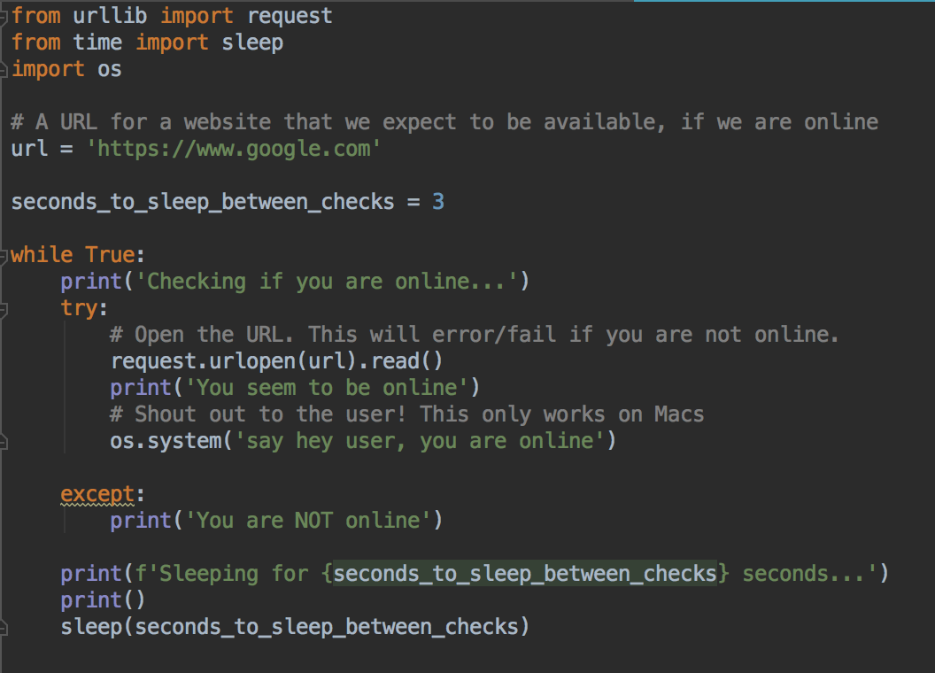
Making a sound when you are online: Mac
Add these lines
runs the say program on MacOS
After say, put any message you like, for example:
os.system('say beep')
os.system('say hello internet!')

Slide 22
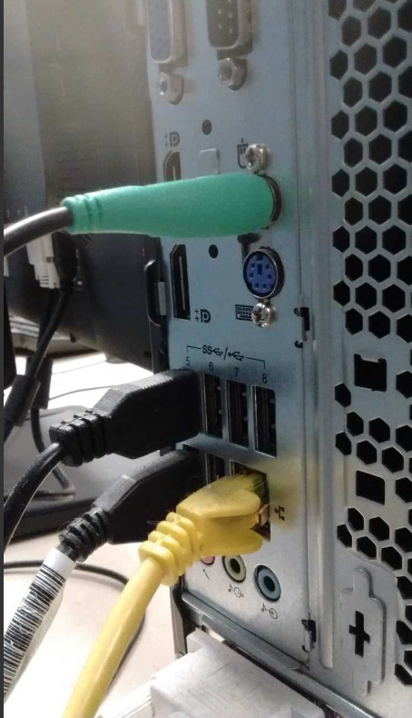
Testing
Laptops: turn your wifi off and on
Lab PCs: unplug the yellow ethernet cable from your PC
Please don't forget to plug it in again
Ethernet cable

Slide 23
Another type of loop - the for loop
Sometimes you know how many times you want to do something
for loops are useful for this

Slide 24
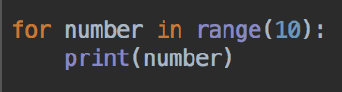
for loops
Start a new Python program
Enter this code
Run and look at the output

Slide 25
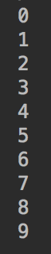
for loops
Run and look at the output
Should be the numbers 0 to 9
Computers start counting from 0
So, if you ask a computer to count ten numbers, it will count
0, 1, 2, 3, 4, 5, 6, 7, 8, 9
The loop repeats 10 times
Can you modify this program to print the numbers 0 to 4?
Can you modify this program to print the numbers 0 to 99?

Slide 26
range()
range() is a function
The range function is useful if you need to do something a particular number of times
It's also useful if you need to count, but don't forget that it will count from 0 to (argument - 1)
10 is the argument to the range function

Slide 27
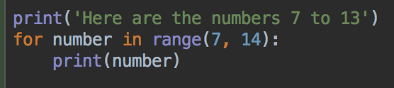
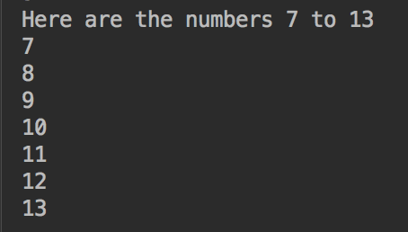
range()
Can customize where to start counting from by modifying the arguments
Can you write a loop that prints the numbers 4, 5, 6, 7, 8?
Can you write a loop that prints the numbers 100 to 200?

Slide 28
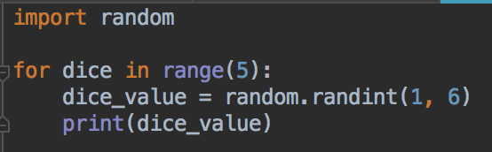
Rolling 5 dice
Write this program, run and test
Let's think about some improvements
It's not very flexible - what if we want to roll 3 dice?
How does the user know what the program does?

Slide 29
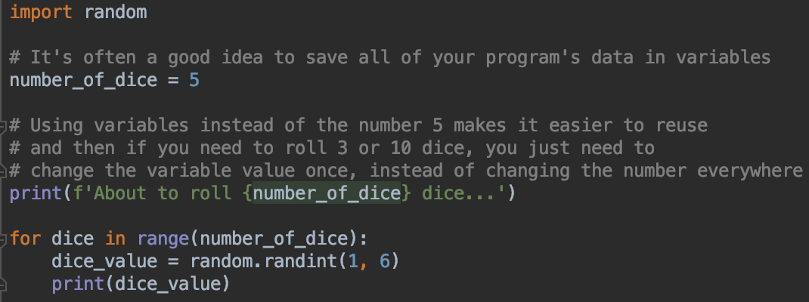
Rolling dice v2
And, move the number of dice to a variable
A message for the user

Slide 30
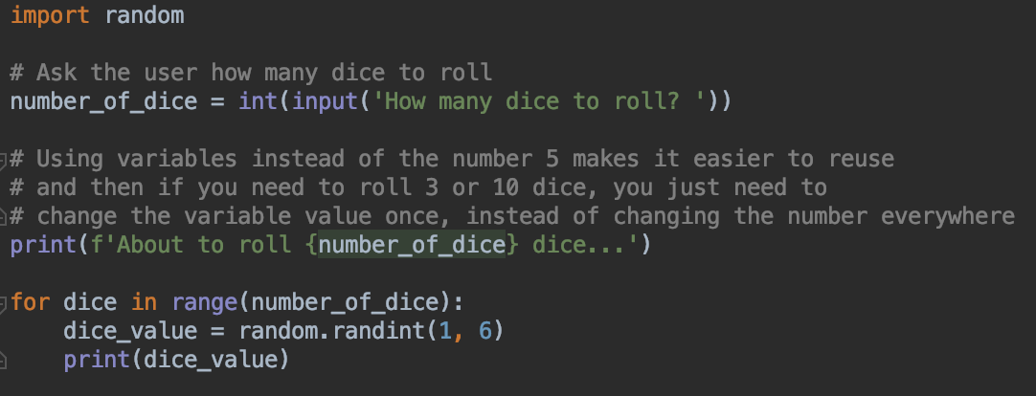
Rolling dice v3
input statement – user can customize program

Slide 31
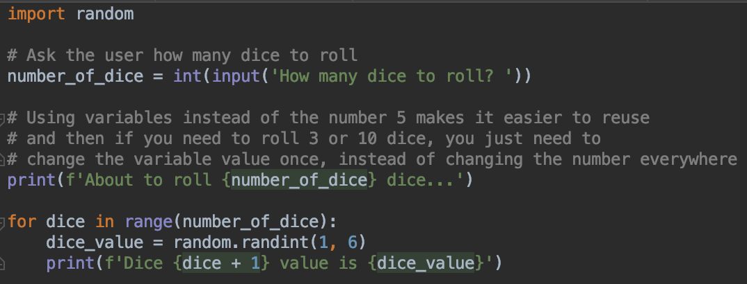
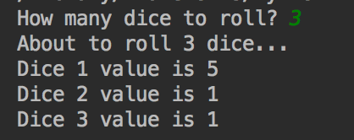
Rolling dice v4
Make output more informative using format string
Notice you can do math and other operations within a format { }
What would the output look like without the +1 ?

Slide 32
for loops
As with while loops, you can put any logic you like inside the for loop
So you can write if statements inside for loops
Or more for loops inside for loops
Or a while loop inside a for loop
Or whatever you need to solve the programming problem

Slide 33
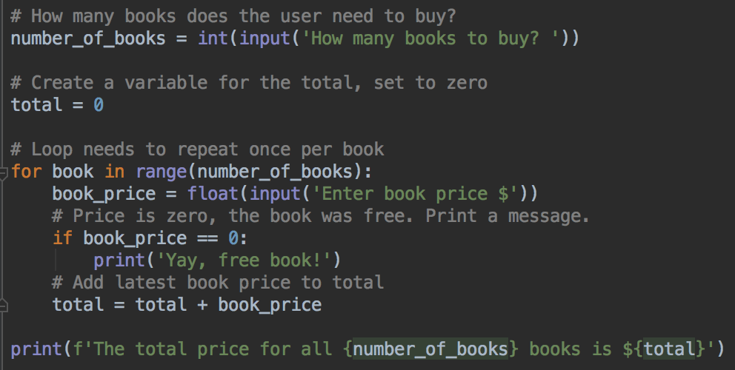
for loops and if statements

Slide 34
for vs while
Two types of loops - which one to choose?
We wrote a very similar program to add up textbook prices as a for loop, and as a while loop
It turns out that you can write most loops as a for loop or a while loop
But, some types of problems are easier to write as a for loop
And other problems are usually easier to write as a while loop

Slide 35
for vs while
Two types of loops - which one to choose?
Use a for loop if:
If you have to do something a known amount of times (or you'll have a variable with the number of repetitions in)
If you have to do a task once per row of a spreadsheet, once per pixel, once per character in a string....
Use a while loop if:
You need to repeat forever
You don't know how many times you'll need to repeat
You'll be able to figure out that the loop needs to end while the loop is running

Slide 36
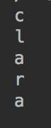
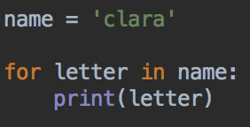
Looping over strings
You can loop over all the letters in a string
Type in this program, but use your name

Slide 37
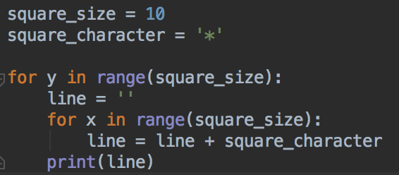
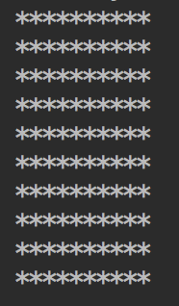
For loop inside for loop
Printing 10 by 10 squares (ok, rectangles)

Slide 38
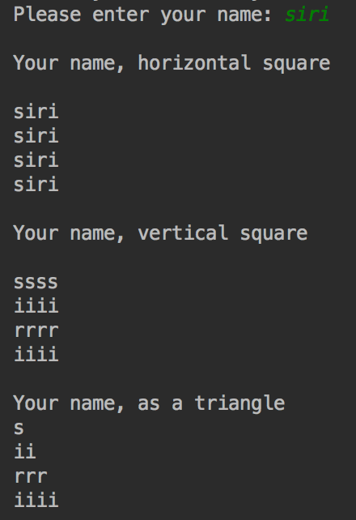
Challenge
Can you print your name in a square?
Easier: print your name horizontally
More challenging: print your name vertically
Super challenge: print your name as a triangle
Your code should work with any name, not just your own
Hint: you can use the len function
Hint 2: you can use the result from the len function as the argument to the range function
Hint 3: vertical and triangle name both need a nested loop

Slide 39
Good programming style
Use concise but descriptive variable names
Comment your code, especially the tricky parts
Use format strings where appropriate
Do all of these when you work on your labs assignments
Next week: points deducted for no comments, poor variable names
Get into good habits now

Slide 40
Lab Time
Lab 3 is in D2L
Start now, finish rest of the questions before next class
Questions? Need help? Ask me or the tutors
Office hours, email, Slack, visit Academic Success Center
Thank you!

